Slide 1
Research and Authentic Inquiry
Dr. Frank LaBanca
labanca@inquirylearningcenter.org
inquirylearningcenter.org

Slide 2
INQUIRY (/inˈkwī(ə)rē/)
Learning by questioning and investigation.

Slide 3
Problem Finding
Problem Solving
Logical/
Analytical
Creative

Slide 4
Problem Finding
Identifying, determining, and defining a problem for study
Recognizing limitations of resources, expertise, materials, access to individuals, time
Examining relevance to create a worthwhile study
Communication of ideas

Slide 5
Problem Solving
Design and application of procedures to solve a problem
Development of:
appropriate approach
proof and documentation of evidence
evaluation of solution
Communication of results

Slide 6
What Einstein has to say about Problem Finding
“The formulation of a problem is often more important that its solution, which may be merely a matter of mathematical or experimental skill. To raise new questions, new possibilities, to regard old problems from a new angle, requires imagination and marks real advance in science.”

Slide 8
Secrets of a Successful Science Project
A fresh idea with exciting consequences.
Thorough understanding of the science/ engineering by the student.
Communicate the idea written and verbally.

Slide 9
The Consumer-Product Testing Trap
Testing a product for what
it’s supposed to do

Slide 10
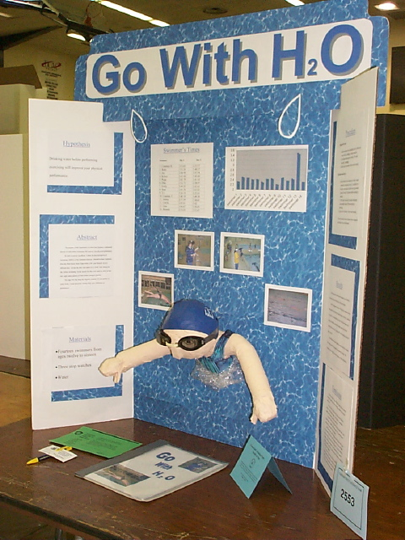
Start Selling With The Title! Title Should Stand Alone!
The topic is not clear without the display.
Topic is clear.

Slide 11
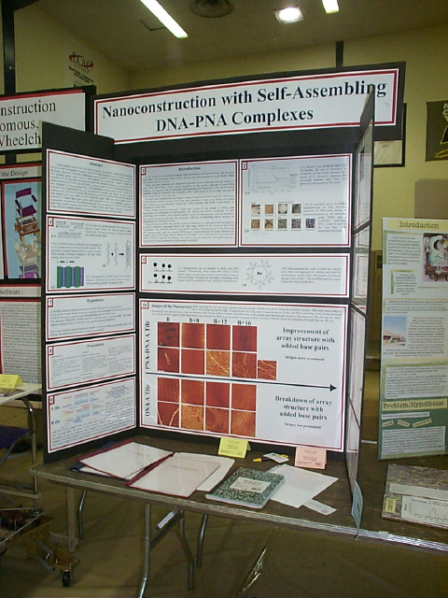
You Be the Judge!
First Impression of a project starts with the title
Based on title alone, judge the 1st, 2nd, & 3rd Honors for a Fair Category.

Slide 12
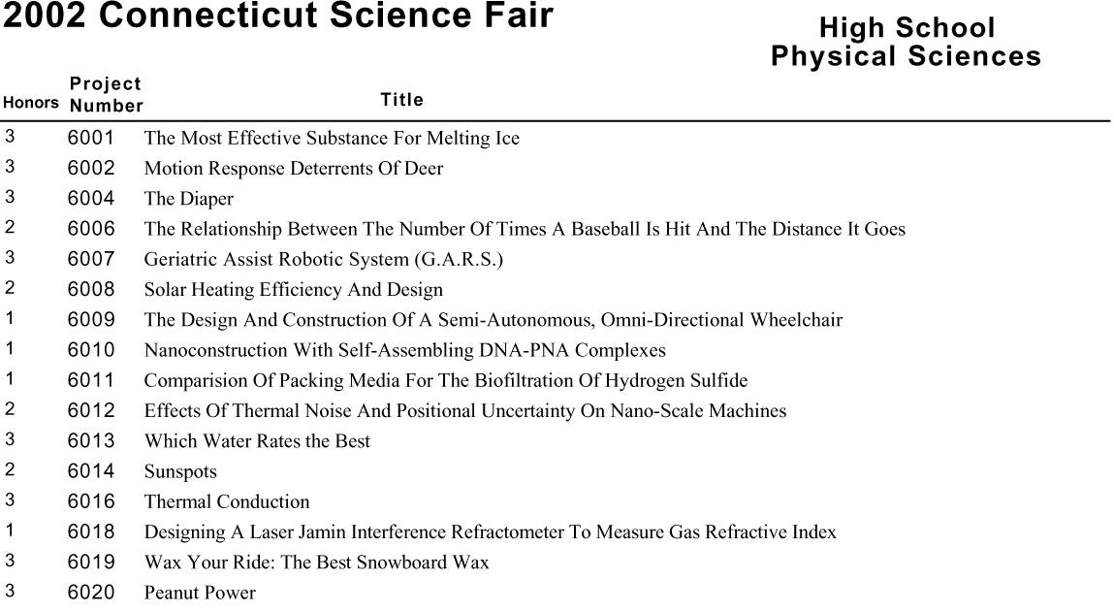
Project Titles Speak Volumes (HS)
YOUR TASK: Pick 1st, 2nd, and 3rd Honors Projects.

Slide 13
Project Titles Speak Volumes (HS)
Here’s what the judges picked.

Slide 14
One Article: Two Approaches
Problem Finding/Ideation
Annotation

Slide 15
Ideation
Generate questions
Quantity over Quality

Slide 16
Annotation
https://www.sciencedaily.com/releases/2016/10/161003103651.htm

Slide 17
Annotation
Purpose/Gist
Big Ideas
Questions
Notes
Definitions
Key References
https://docs.google.com/document/d/1ATAie6v-6fRJutgf1J8kQxMpPwuD5cL7dvoMvVQExkE/edit?usp=sharing

Slide 18
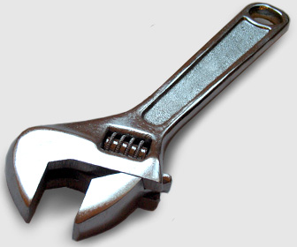
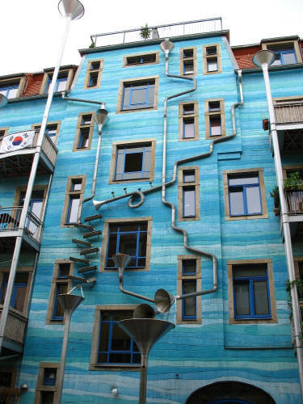
Types of Projects
Literature Review | Technical
Technical with Value | Novel Approach

Slide 19
LITERATURE REVIEW PROJECT
Use source information for all aspects of project
Organize primary and secondary sources into a report
No inquiry

Slide 20
TECHNICAL PROJECT
Inquiry-based
Well known question
Well known outcome
Predetermined procedures
Predictable results

Slide 21
TECHNICAL PROJECT WITH VALUE
Inquiry-based
Technical data
Unique data set – unique niche
Value to an authentic audience

Slide 22
NOVEL APPROACH PROJECT
Novel question
Novel method to solve a preexisting question
Ill-defined question
Ill-defined outcome

Slide 23
Define Project Based on Abstract
Literature Review | Technical
Technical with Value | Novel Approach

Slide 24
Partitioning Gamma-Ray Sources in Fermi Large Area Telescope Observations for Spatial and Spectral Analysis
The Weakly Interacting Massive Particle (WIMP) theory for dark matter predicts the production of gamma radiation from WIMP annihilation and decay. To examine the possibility of WIMP dark matter, gamma ray sources from M31 are partitioned from the Fermi Gamma-ray Space Telescope from the LAT instrument with 5 years of clean and ultraclean cut-data in the 1 – 300 GeV range. Background, halo, and point source distributions are then used in a spectral and spatial analysis. The spectrum is well described by a power law, but the polar averaged radial density is a good fit with a line of sight integral of the linear and squared Navarro - Frenk - White (NFW) density profile with an R^2 = 0.9992. The NFW fit also exhibits a significantly larger contribution coefficient from decay processes than annihilation. The correlation between theory and predictions suggests that either WIMPs are the source of the radiation, astrophysical processes are influenced by dark matter that follows this density fall off, or astrophysical processes follow this profile randomly. These findings raise fundamental questions on the origin of galactic halo gamma rays, and warrants continued research in the field.

Slide 25
Temperature-Independent, Portable, and Rapid Field Detection of Ebola via a Silk-Derived Lateral-Flow System
Up to 90% of Ebola victims will die without early diagnosis and medical intervention, which can reduce fatalities by 50% and are critical to preventing future epidemics. Current detection methods are expensive, time-consuming and utilize complex instrumentation and chemicals that require uninterrupted refrigeration. Successfully maintaining the reagent's “cold-chain” from laboratory to point of use is highly problematic in regions with poor infrastructure, where Ebola is most common. This research sought to devise a rapid, simple and inexpensive Ebola detection platform that can be stored and transported without refrigeration. To begin, current Ebola ELISA reagents were embedded in silk fibroin, which possesses stabilizing properties, allowing storage of otherwise refrigerated reagents at room temperature. To confirm ELISA colorimetric detection of Ebola after prolonged, non-refrigerated storage of the kit's reagents, the Ebola ELISA was conducted in a 96-wellplate format (A450nm) at 0-7days from initial mixing and dilutions. Results indicate Ebola ELISA detection is viable in water dilutions only on the day of mixing. For silk-embedded reagents, successful detection was realized for up to one week of RoomTemp-storage. Silk-film embedded Ebola ELISA reagents were used to construct a four-channel, paper-based, fluidic detection card, with colorimetric reagents positioned to create timed, visible detection of Ebola antigens. In this new device, that is stable and stored at room temperature, 30µl drops of water were used to dissolve silk-embedded reagents, initiating a timed-flow towards a center detection zone, where a positive (colored) result confirmed the presence of 500pg/ml Ebola(+)control antigens in 30min, at a cost of $25.

Slide 26
The Effects of Barefoot and Shod Running on Risk of Injury in High School, Female, Recreational Runners
While previous studies have investigated the incidence of injuries among high school cross country runners, there has yet to be a study conducted to compare barefoot and shod running in this population. My experiment investigates the influence of these two conditions on biomechanical risk factors that have previously been associated with injuries in female high school runners. Eleven recreational runners participated in this study. Ten trials were conducted per condition for each runner. A trial was defined as one run down the fifty foot long track with the runners striking the force plate with their right foot. Step frequency, step length, contact time, knee flexion angle in the stance phase, sole angle at touchdown, the peak impact force, and the length of time the maximum force was sustained for were compared between both conditions. Stride length and contact time were both shorter in the barefoot condition, which led to less prominent rearfoot striking among the majority of runners. The knee flexion angle and sole angle were also smaller when barefoot, which are both impact reducing mechanisms. Impact forces were higher in the barefoot condition, as was expected for runners who typically run with shoes. However, other biomechanical adaptations were clearly made. This includes a shorter period of time during which the maximum force was sustained during barefoot running in comparison to shod running. This information could be used to support a prospective study that follows barefoot and shod high school runners to determine the incidence of injury in each group.

Slide 27
Novel Glycerol-Free Biodiesel Production using Enzyme Catalysis
Biodiesel production from vegetable oil and ethanol (EtOH) has become a demonstrated alternative energy source. Current processes convert triglycerides to biodiesel, from which 90 million pounds of crude glycerol, a waste product, is extracted per annum in the US. Last year, a new method of production was formulated to avoid glycerol formation using selective partial transesterification; preliminary data required additional research to verify early findings and support the method reliably. This project investigates the effectiveness of the addition of acetic acid (AcOH) to the enzymatic process to prevent the formation of glycerol by inducing faster transesterification of the terminal alcohols. Gas chromatography and mass spectrometry (GC/MS) analyses were applied in order to identify intermediate compounds’ structures dependably. Using GC/MS and dodecane, an internal standard (IS), to track formation of the new products, the reaction’s stability was demonstrated. Glycerol was continually absent from the invented EtOH+AcOH reaction, supporting the hypothesis that stopping the process at the monoacylglycerol (MG) stage results in a 100% yield of good-quality biodiesel. Furthermore, the reaction of MG acetate, formed under anhydrous conditions, was tracked after the addition of water, experimentally verifying its structure. In the EtOH+AcOH experiment, 8% MG acetate was formed; its complete hydrolysis in the presence of water resulted in a 10% increase in biodiesel and 0.12% increase in MG. These results indicate that the EtOH+AcOH method for biodiesel production is a sound, efficient, and applicable process to prevent waste glycerol formation at minimal cost.

Slide 28
Polyetherketoneketone (PEKK), 3D Printed, Bipartite Surgical Implant: An Alternative and Supportive Cure for Internal Coxa Saltans in Female Adolescents
Coxa Saltans, a condition of the hip, comes in three forms that manipulate a snap, but the contributing factors vary. Internal Coxa Saltans, on which this research focuses, occurs when the iliopsoas muscle-tendon snaps over bony protrusions on the front of the pelvis. The condition is commonly seen in female adolescents due to the hips growing faster than the muscle-tendon can accommodate. The muscle-tendon cannot span such a large area without complications. This results in a tight, inflamed iliopsoas that is prone to snapping. Basic treatment is administered and if the snapping persists and becomes increasingly painful, lengthening of the tendinous fibers of the iliopsoas muscle-tendon is performed. Research has shown that this method removes valuable support from the patient’s hip joint. This research seeks to design, 3D print, and mechanically test a bipartite surgical implant that prevents the snapping and provides support for the patient. Using Solidworks, the two parts of the implant were designed, combining the properties of a doorstop and channel like mechanisms. The bipartite implant was 3D printed and then tested mechanically via an Instron machine. The implants were tested for compressive strength in different orientations. When tested mechanically, the femoral implant failed at a load of approximately 1,240 N and the pelvic implant failed at a load of approximately 720 N. Taking the general anatomy of the hip and the strength of the implants into account, it can be concluded that the implant design can provide required support to the hip, while also preventing the snapping.

Slide 29
Thank You

