Slide 1
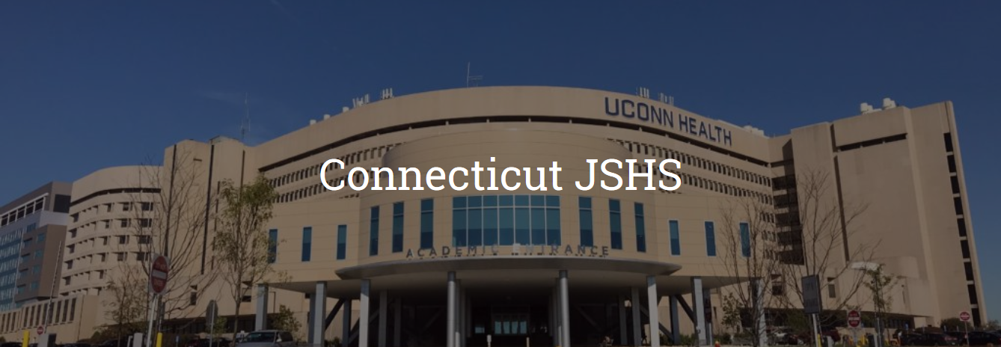


March 7, 2020
UCONN Health
Farmington, CT

Slide 2

Junior Science and Humanities Symposium
History
National
Regional
Sponsors

Slide 3

Registering for CT-JSHS
On-line registration
Opens October 23, 2019
December 13, 2019 Deadline
Abandoned registrations
Observer versus presenter
Chaperone Status

Slide 4
Presenting at CT-JSHS
Who can present at the Connecticut Regional JSHS?
Any high school student from the Connecticut region may submit an application for consideration.
How do I present at the Connecticut Regional JSHS?
By December 13, 2019, ALL students must register and complete the Student Application for the CT-JSHS. After initial registration, students wishing to apply to present their research must return to the application to add their research materials by the January 6, 2020 deadline.
By January 6, 2020 students who wish to present their research at the CT-JSHS must submit an abstract, Mentor Form, short answer question and a link to their 3-minute video.
A review committee will view all completed student applications and evaluate them. The committee will then meet to decide which students will present at this year’s CT-JSHS. A maximum of 15 students will be invited to present their projects in Oral Competition. A maximum of 16 students will also be invited to present their projects in Poster Competition. And a maximum of 40 students will be invited to present their projects in the noncompetitive STEM Exhibition Poster Session.
Students will be notified of their selection to present in one of the three sessions by January 27, 2020.

Slide 5
What’s in the Student application?
Abstract – 250 words
Title of their project
Answer 4 questions about their research
Mentor for must be downloaded, filled out and signed by mentor
3 Minute video

Slide 6
Selection Process
Limit of 10 students from any one school may apply
For competitive sessions only 3 students from any one school may participate
On-line process
30 – 40 reviewers
5 reviewers per project
A mix of experts, educators and long time JSHS Executive Committee members
Final in-person review meeting

Slide 7
CT-JSHS – Seize the day

Slide 8
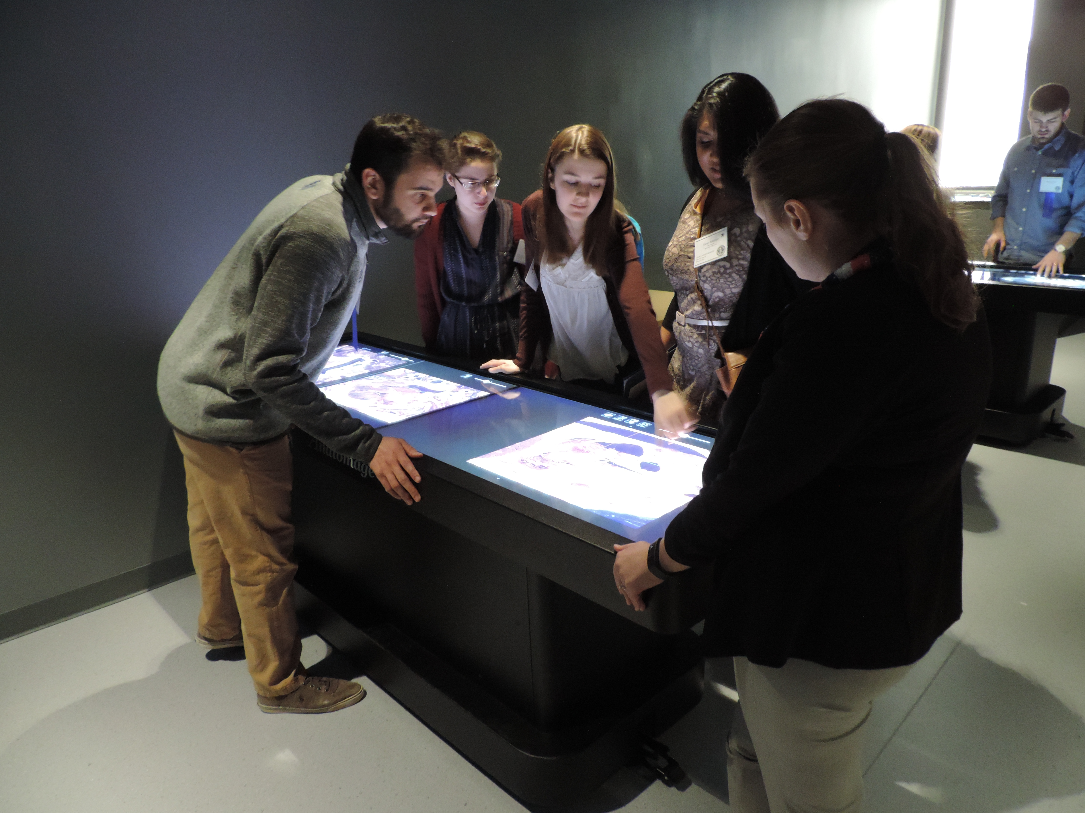
An Observer

Slide 9
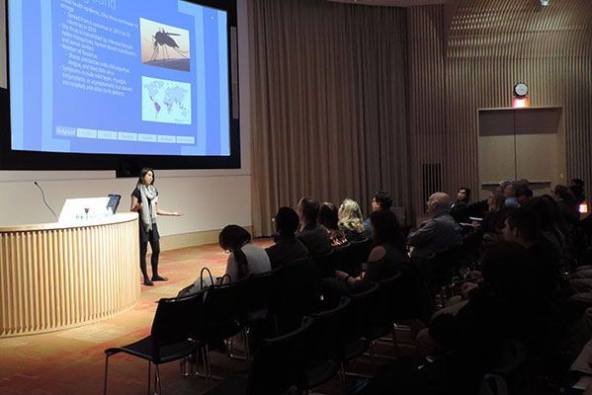
An Oral Presenter

Slide 10
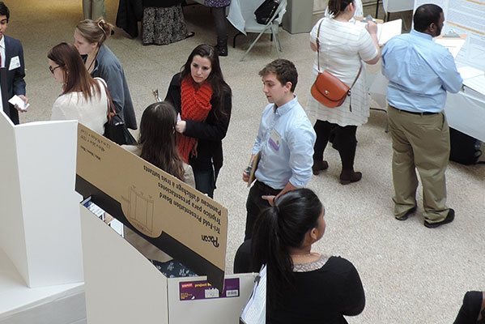
A Poster Presenter

Slide 11
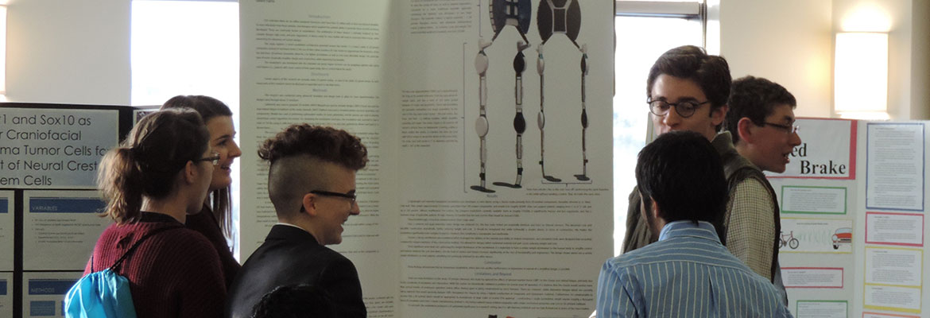
STEM Exhibitor

Slide 12
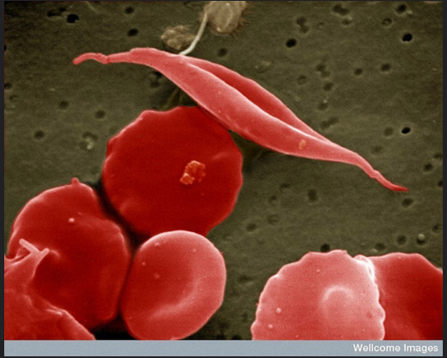
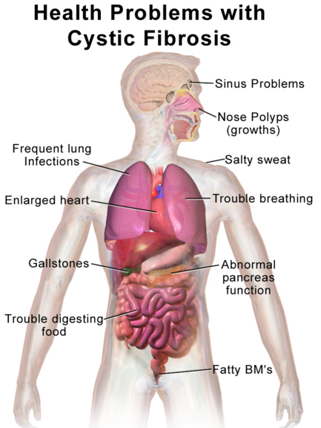
Humanities Activity
Welcome Images, CC BY-NC-ND 2.0
Research is on-going to develop
gene therapies for conditions such as cystic fibrosis and sickle cell disease
Blausen.com staff, CC BY 3.0

