Slide 1
Teacher Conference
Connecting NGSS to independent research
September 21, 2019

Slide 2
So what’s the connection
Authenticity
Identity
Practice
Being Ready

Slide 3
Critical Thinking and Communications Skills
Notes:
How are critical thinking and communications skills, which are fundamental to student success in today’s global economy, addressed in the Next Generation Science Standards?
It is important to understand that the scientific practices in the Next Generation Science Standards (NGSS), as defined by the National Research Council (NRC), include the critical thinking and communication skills that students need for postsecondary success and citizenship in a world fueled by innovations in science and technology. These science practices encompass the habits and skills that scientists and engineers use day in and day out. In the NGSS these practices are wedded to content. In other words, content and practice are intertwined in the standards, just as they are in the NRC Framework and in today’s workplace.

Slide 4
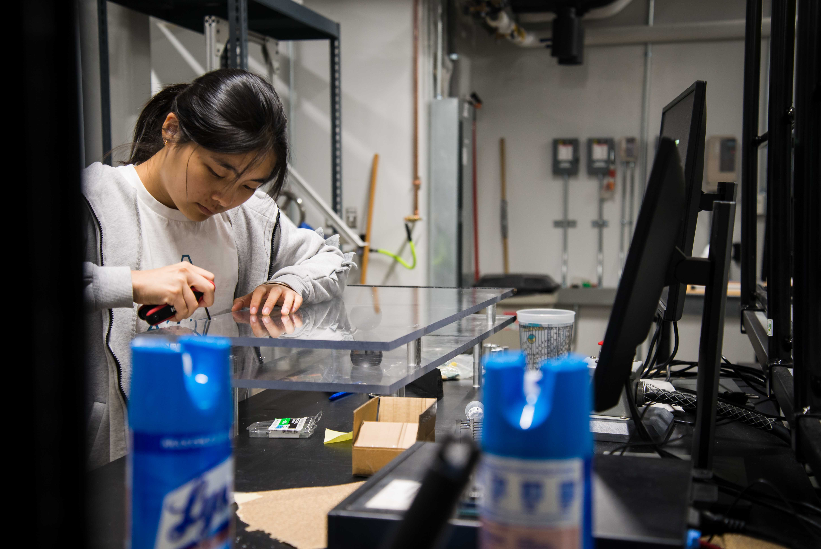
Core Ideas
four domains—life sciences, physical sciences, earth and space sciences, and engineering
https://belinblank.education.uiowa.edu/students/sstp/img/gallery_1.jpg
Notes:
Have broad importance across multiple sciences or engineering disciplines or be a key organizing concept of a single discipline;
Provide a key tool for understanding or investigating more complex ideas and solving problems;
Relate to the interests and life experiences of students or be connected to societal or personal concerns that require scientific or technological knowledge;
Be teachable and learnable over multiple grades at increasing levels of depth and sophistication.

Slide 5
STEM Practices
Asking questions (for science) and defining problems (for engineering)
Developing and using models
Planning and carrying out investigations
Analyzing and interpreting data
Using mathematics and computational thinking
Constructing explanations (for science) and designing solutions (for engineering)
Engaging in argument from evidence
Obtaining, evaluating, and communicating information
Notes:
The ways we describe student engagement in science have evolved over time. Terms such as “hands-on” and “minds-on” have traditionally been used to describe when students engage in science. “inquiry-based science” is refined and deepened by the explicit definition of the set of eight science and engineering practices, Engagement in any of the science and engineering practices involves both scientific sense-making and language use (see Figure D-1). Engagement in these practices is also language intensive and requires students to participate in science discourse. Students must read, write, and visually represent as they develop models and construct explanations. They speak and listen as they present their ideas or engage in reasoned argumentation to refine their ideas and reach share conclusions.
These science and engineering practices offer rich opportunities and demands for language learning while they support science learning for all

Slide 6
Crosscutting Concepts
Patterns
Cause and effect: mechanism and explanation
Scale, proportion, and quantity
Systems and system models
Energy and matter: flows, cycles, and conservation
Structure and function
Stability and change

Slide 7
Where When and How to do research
Summer, Fall, Winter or Spring
In School, Home or Natural setting
At a University or Commercial Lab
publicly available data sets
citizen science project
working with a local expert or university faculty mentor
Summer in CT
In Health
Help from my Colleagues at Iowa JSHS
Notes:
Research can happen in a wide variety of settings. Past JSHS participants have conducted research on their family’s farm, using publicly available data sets, in an ag or science classroom, through participation in a citizen science project, or from working with a local expert or university faculty mentor. Whatever the research project, when students participate in Iowa-JSHS, they write research papers detailing their investigations and submit it as a proposal to present at Iowa-JSHS. The proposal submission deadline also creates authentic space that imposes the need for students to set continual goals throughout their research projects.

